Slide 1
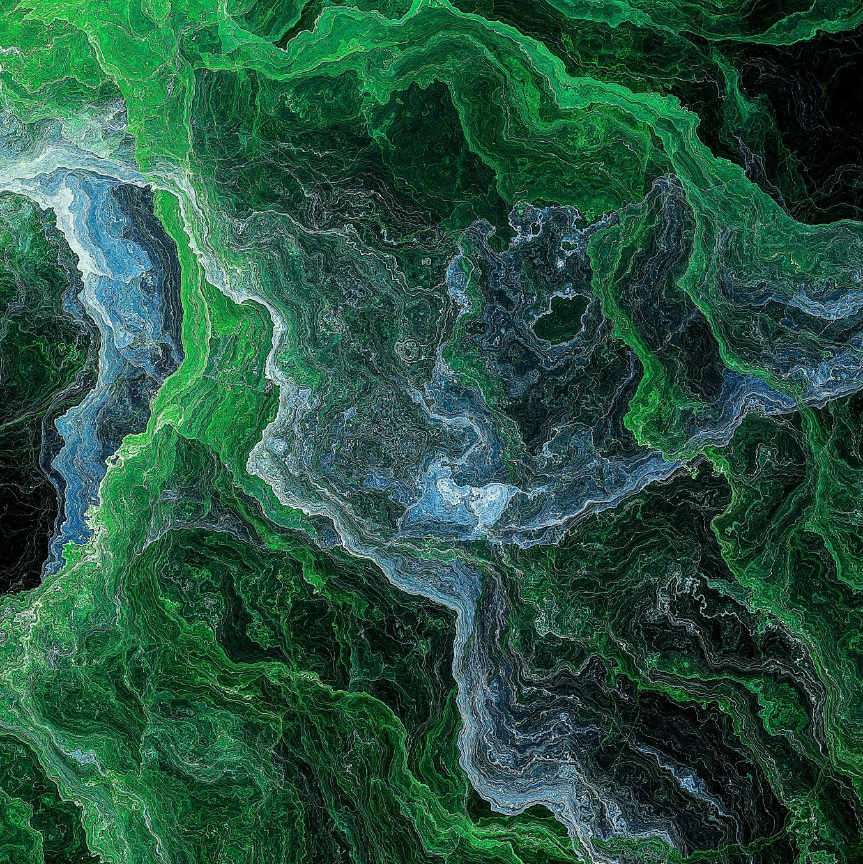
Automated Content Generation system Project
Inspire AI
Content Flow

Slide 2
Members of the team
1. Mohammed Saieed Abdelnaby 2. Gehad Abdallah Mohammed 3. Abdelrahman Mamduh Eldwiny 4. Ayat Abdelnaby mohammed Hussain 5. Mohammed Saeed fath-elbab 6. Mahmoud taha abdelmaboud behery

Slide 3
Introduction
Who We Are: We are a team of AI engineers with a passion for creating intelligent solutions that empower users in their daily tasks and creative projects.
Our Mission: We aim to simplify and enhance user interactions with AI technologies through two innovative applications:
AI Writing Assistant: Our first application focuses on helping users create custom AI models designed to assist with content generation. Whether users need help with drafting articles, solving specific writing challenges, or generating creative text, this tool allows them to train and fine-tune AI models tailored to their unique needs.
Prompt Optimizer for AI Image Models: In our second application, we guide users to generate more effective and creative prompts for AI-generated image models, such as Stable Diffusion and Flux. By helping users craft better prompts, we unlock the full potential of these models, leading to more accurate, artistic, and visually stunning results.
Why It Matters: We bridge the gap between users and powerful AI technologies, making AI more accessible, customizable, and effective for a variety of creative and problem-solving tasks

Slide 4
Methodology
AI Writing Assistant:
Model Utilized: Llama 3.2 3B, a state-of-the-art language model known for its efficiency and accuracy in generating human-like text. Prompt Engineering: Instead of fine-tuning, we employed prompt engineering to guide the model in generating content tailored to user requirements. Users provide input prompts specifying their desired tone, style, and content type, and the system generates relevant text accordingly. Features: Includes custom model settings for tone, style, and content type.
Prompt Optimizer for AI Image Generation:
Prompt Enhancement: Uses natural language processing (NLP) techniques to help users refine their prompts.
Compatibility: Works seamlessly with popular image models like Stable Diffusion and Flux.

Slide 5
System Design
AI Writing Assistant Design:
Architecture:
User input → Prompt Engineering → AI Model → Output (Generated Text).
Core Features:
Customizable parameters, content suggestions, and feedback loop for improving text quality.
Prompt Optimizer Design:
Architecture:
User input (initial prompt) → NLP Enhancer (LLM) → Optimized Prompt
User input (Image) → Image-Text-to-Text(VLM) → Image Caption→ NLP Enhancer (LLM) → Optimized Prompt
Core Features:
Prompt suggestions, keyword optimization, and style preferences.

Slide 6
Implementation Process
Technologies Used:
For AI Writing Assistant: Utilized LLM models with Python and Hugging Face libraries for model customization.
For Prompt Optimizer: Employed NLP frameworks and API integrations for interaction with models like FLUX.
Development Phases:
Research and design.
Model selection and training.
Frontend and backend development.
Testing and refinement.
Challenges:
Ensuring model accuracy while maintaining user-friendly interfaces.
Managing computational resources for real-time prompt optimization.

Slide 7
Results
AI Writing Assistant:
Enabled faster and more efficient content creation.
Easy to use, customizable, and accessible for various users.
Prompt Optimizer for AI Image Models:
Improved image quality through better prompt refinement.
Enhanced user experience and smoothly integrated with popular AI models.

Slide 8
Discission
Strengths:
AI Writing Assistant:
Efficient and fast content generation.
Highly customizable, allowing users to adjust tone, style, and format easily.
Prompt Optimizer for AI Image Models:
Improved image generation accuracy through prompt refinement.
Seamless integration with popular AI models like Stable Diffusion and Flux.
Weaknesses:
AI Writing Assistant:
Limited in handling very specialized or highly technical content.
May require further fine-tuning for complex tasks.
Prompt Optimizer:
Can still struggle with very abstract or unconventional prompts.
The quality of image output depends heavily on the user’s initial input and refinement process.

Slide 9
Why We Chose These Models ?
1. General Model Feedback
1
Florence-2:
Adding fictional info... like sitting on a bench and looking at sky while there is no sky, stuff like that.
Couldn't identify if the person is a woman or man.
joyCaption:
Very good model with very good output (could identify that the dress is semi-transparent ) but we couldn't find its source code as it's Chinese and they use COMFY UI.
2. Model Performance Issues
2
qwen2-VL:
very good results
can’t be run even the 2B on colab.
Couldn’t access it on Kaggle
nano llava:
Can't describe the complex photos.
llava-v1.6-vicuna and llava 1.5v:
Not good outputs.
Mistral 7B, mixtral 8x7B:
Both couldn't work.
Molmo-7B-D-0924:
Can’t be run on Kaggle
LLM:
llama 3.2 1B low quality output
llama 3.2 11B (VL) --> Less details and the other couldn't work on collab.
3. Successful Model Performance
llava-v1.6-mistral-7b-hf:
Perfect... could identify the dress, the woman, and no fictional adding.
llama 3.2 3B:
Decent output.

Slide 10
Acknowledgement
We would like to extend our heartfelt gratitude to our instructor and supervisor, ENGINEER EHAB IBRAHIM. Your guidance and expertise have been instrumental in our project’s success.
We also want to thank the Ministry of Communication for providing us with this invaluable internship opportunity. This experience has allowed us to apply our knowledge in a practical setting and gain insights into the field of AI technologies. Your support has enabled us to learn and grow, and we appreciate the trust you placed in us.
Thank you for fostering an environment of learning and innovation, where we could explore our potential and develop our skills.

